Slide 1
CSC3002 Introduction to Computer Science: Programming Paradigms
HUANG, Rui
SSE, CUHK(SZ)
Spring, 2019

Slide 2
Lecture 0: Introduction to CSC3002
Who?
When?
Where?
What?
Why?
How?
…

Slide 3
Who?
Who are teaching this course?
Instructor: Prof. HUANG, Rui (ruihuang@cuhk.edu.cn) 408 Chengdao Bldg., 84273856
TAs:
WANG, Shuai (216019013@link.cuhk.edu.cn)
ZHU, Minghe (217019020@link.cuhk.edu.cn)
SUN, Qinbo (218019050@link.cuhk.edu.cn)
USTFs:
HAO, Senyue (116010062@link.cuhk.edu.cn)
LAN, Yifan (116010103@link.cuhk.edu.cn)
YE, Chengwei (116010265@link.cuhk.edu.cn)

Slide 4
Who?
Who should take this course?
Sophomores of CSE, Major Required! (Juniors of DS to be added.)
Juniors/Seniors of other SSE majors, Major/Free Elective
All other students, only if you understand the following:
Pre-requisite:
CSC1001 Introduction to Computer Science: Programming Methodology (and preferably the lab course CSC1002)
Preferable:
CSC3001 Discrete Math
EIE2050 Digital Logic and Systems
Willingness to spend (a lot of) time in this course!

Slide 5
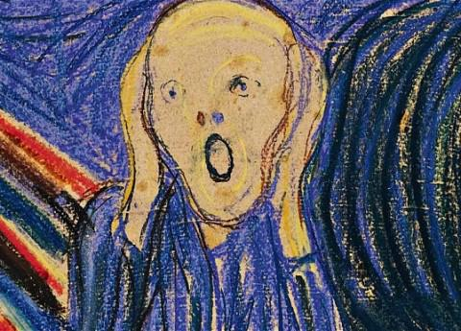
When and where?
Lectures
Wednesday and Friday, 8:30~10:00, 10:30~12:00
111 Zhixin Bldg.
Tutorials
Wednesday, Thursday, and Friday, 20:00~21:00 （No tutorial this week.)
TD_314/414 (Parallel sessions to be combined together.)
Office hours
WANG, Shuai: Tuesday 9:00~11:00, 320A Chengdao Bldg.
ZHU, Minghe: Thursday 9:00~11:00, 320A Chengdao Bldg.
SUN, Qinbo: Thursday 15:40~17:40, 520 Zhiren Bldg.
Two repeated sessions!

Slide 6
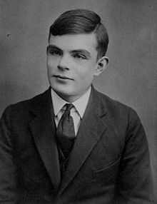

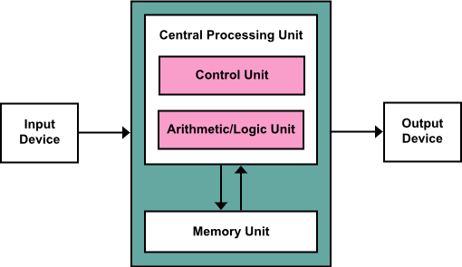
What? … is a program
Alan Turing:
Father of theoretical computer science and artificial intelligence
Turing machine, Turing test, Turing Award
John von Neumann: Practical computer architecture
Von Neumann architecture (stored-program computer)

Slide 7
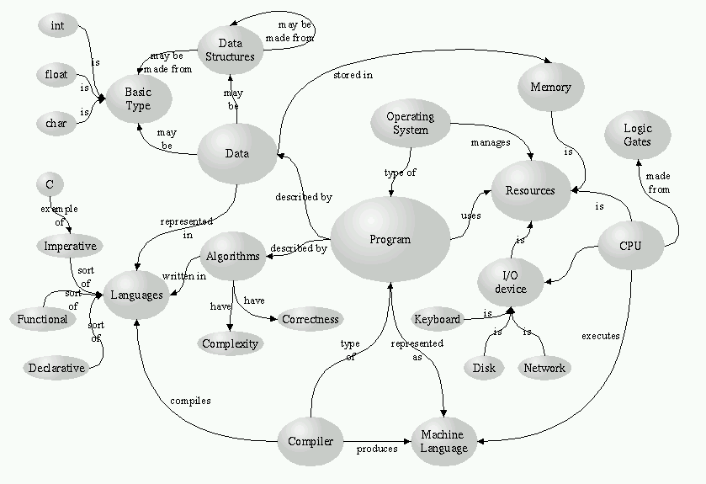
Computer science and engineering: a big picture http://cs-alb-pc3.massey.ac.nz/notes/59102/mindmap.gif

Slide 8
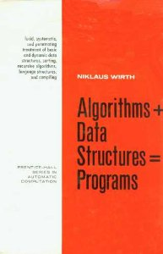
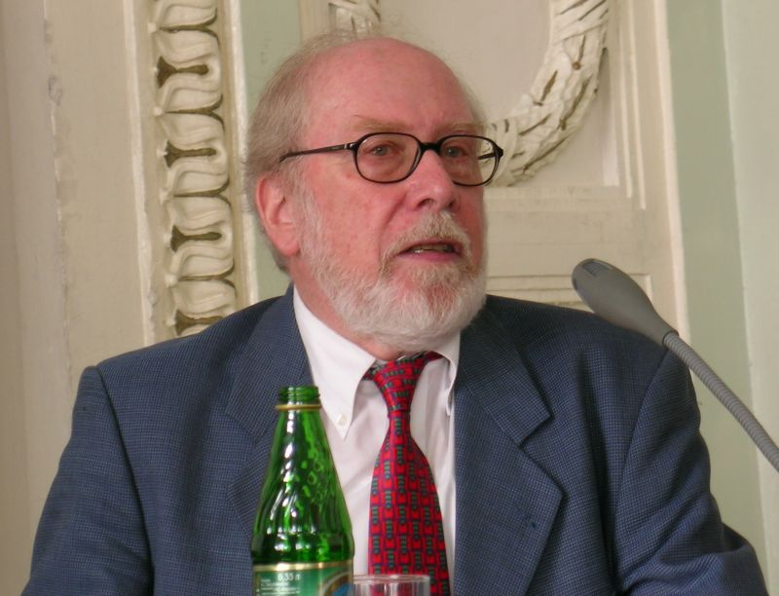
What? … is a program
Algorithms + Data Structures = Programs
-- Niklaus Emil Wirth
Computer Scientist
Turing Award winner
Father of the Pascal language

Slide 9
What? … is computer science
● AL - Algorithms and Complexity
● AR - Architecture and Organization
● CN - Computational Science
● DS - Discrete Structures
● GV - Graphics and Visualization
● HCI - Human-Computer Interaction
● IAS - Information Assurance and Security
● IM - Information Management
● IS - Intelligent Systems
● NC - Networking and Communications
● OS - Operating Systems
● PBD - Platform-based Development
● PD - Parallel and Distributed Computing
● PL - Programming Languages
● SDF - Software Development Fundamentals
● SE - Software Engineering
● SF - Systems Fundamentals
● SP - Social Issues and Professional Practice
Computer Science Curricula 2013
Curriculum Guidelines for Undergraduate Degree Programs in Computer Science
Association for Computing Machinery (ACM) & IEEE Computer Society

Slide 10
What?
Course placement: in CSE curriculum

Slide 11
What?
Course placement: in programming related courses
Introduction to Computing
Programming Methodology
Programming Abstractions
Programming Paradigms
Data Structures
Algorithms
Software Engineering
Parallel/Distributed/Cloud Computing
Mobile Computing, Web Computing, etc.
Programming Languages
Compilers
Programming I
Programming II
Algorithms + Data Structures = Programs
Strongly related, more theoretical aspects

Slide 12
What? Core concepts
Abstraction Learn a variety of abstract data types that will prove to be enormously valuable as you write programs.
Recursion Recursion is an enormously powerful technique that enables you to solve complex problems that you would never be able to solve without it.
Representation and algorithmic efficiency Different algorithms can vary enormously in terms of the amount of time and space required to solve a particular problem.
Object-oriented programming Encapsulation, inheritance, polymorphism.
Programming paradigm A set of programming principles, following which makes a paradigm the best for a certain kind of problem.

Slide 13
What? Syllabus
An overview of the C++ programming language
Programming basics: functions, libraries, strings, streams, collections
Object-oriented programming: objects, classes, inheritance
Recursion
The C++ memory model: pointers, arrays, dynamic memory management
Algorithmic analysis, efficiency and representation
Linear structures: stacks, queues, vectors
Advanced structures: maps, trees, sets, graphs
Programming paradigms

Slide 14
What? Teaching plan
Week | Content | Activity
1/9~1/11 | Course Introduction and an overview of C++
1/16~1/18 | Functions and libraries | Add and drop due
1/23~1/25 | Strings and streams | Assignment 1
2/20~2/22 | Collections | Assignment 1 due
2/27~3/1 | Object-oriented programming I: classes
3/6~3/8 | Recursion
3/13~3/15 | Algorithmic Analysis | Project proposal due
3/20~3/22 | Midterm exam | Proposal Presentation
3/27~3/29 | The C++ memory model | Assignment 2
4/3~4/5 | Efficiency and representation | Assignment 2 due
4/10~4/12 | Linear structures: stacks, queues, vectors
4/17~4/19 | Advanced structures I: maps, trees, sets
4/24~4/26 | Advanced structures II: graphs
5/1~5/3 | Object-oriented programming II: inheritance | Assignment 3
5/8~5/10 | Programming paradigms | Assignment 3 due
5/14~5/18 | Final exam | Project and report due

Slide 15
What? Activities
Three sets of programming assignments
Normally posted on Fridays, and due a week later.
Project
Groups of 4~6 students, teaming up by yourselves.
Project proposal due on the Friday before the midterm exam week.
Project proposal presentation is the midterm exam.
Project code and report due on the Friday of the final exam week.
Written exam in the final exam week

Slide 16
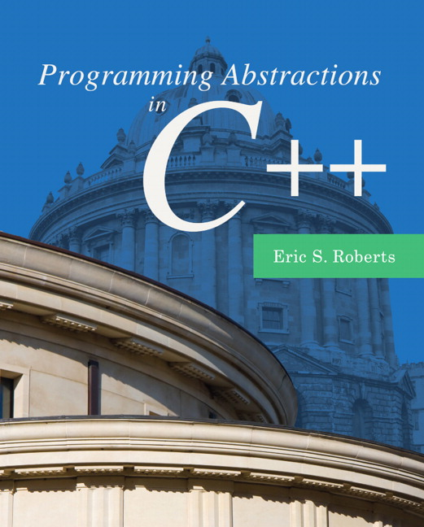
What?
Textbook:
Programming Abstractions in C++,
Eric Roberts, Pearson.
The author’s course reader: Read it!
http://cs.stanford.edu/people/eroberts/courses/cs106b/materials/CS106BX-Reader.pdf
All lecture notes and sample code used in classes will be provided to the students via Blackboard (https://bb.cuhk.edu.cn/), normally uploaded on Fridays, with preview material for the next week.
Remember to check BB or your email for official announcements!

Slide 17
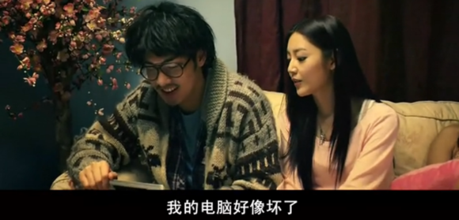
Why? … do we learn computer science

Slide 18
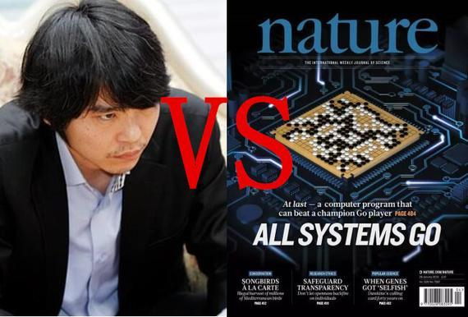
Why? Age of AI
A new boom in Artificial Intelligence (AI), thanks to
Big data
Cloud computing
Deep learning
Mobile internet boom
Smartphones
Wireless communication
Cloud computing & storage

Slide 19
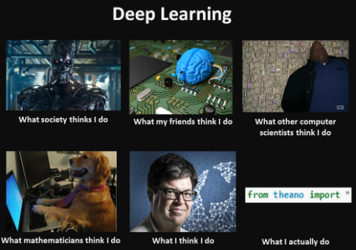
Why? Age of AI

Slide 20

Why? … do we learn programming
Programming is just generally awesome
-- Julie Zelenski@Stanford
Learn relatively small set of fundamentals, but infinitely combinable to solve all sorts of problems
Build impressive things that you can be proud of
Nothing more satisfying than finding and fixing that last bug

Slide 21
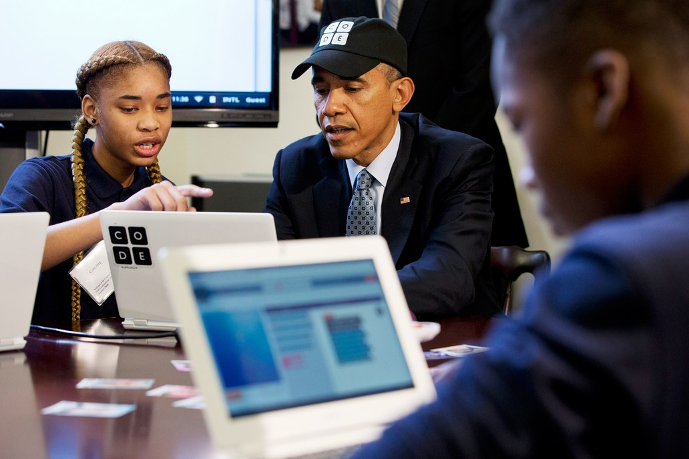
Why? … do we learn programming
Former President Obama announces computer science for all initiative
“In the coming years, we should build on that progress, by … offering every student the hands-on computer science and math classes that make them job-ready on day one.”
—President Obama, 2016 State of the Union Address
Obama becomes first US president to write a computer program.

Slide 22
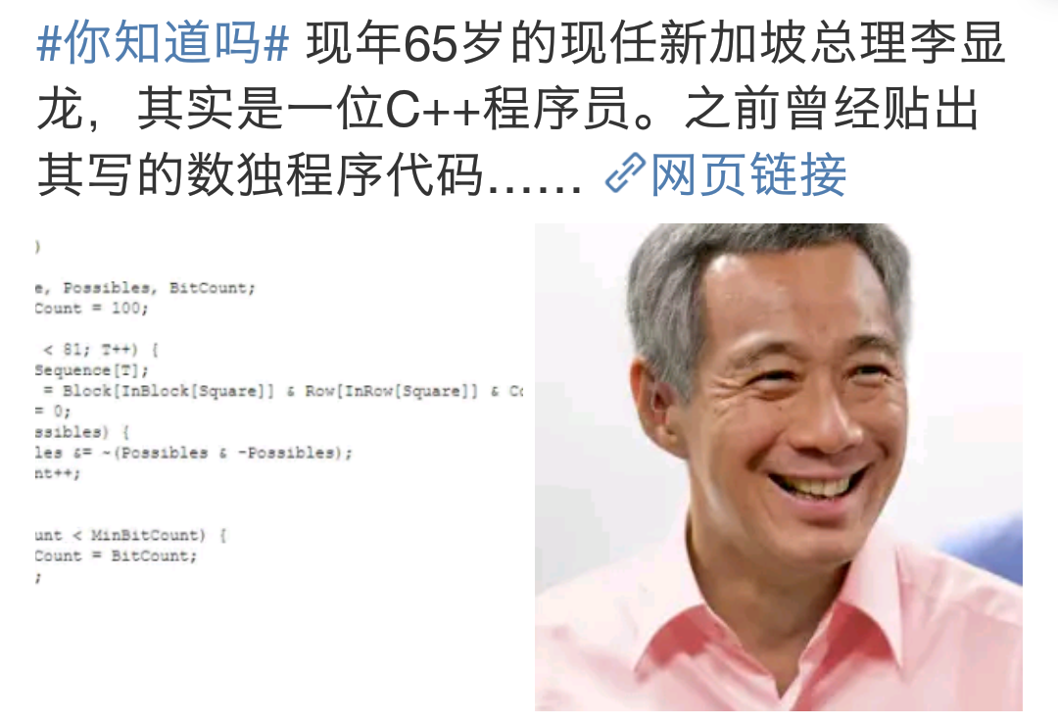
Why? … do we learn programming
In the eastern world…

Slide 23
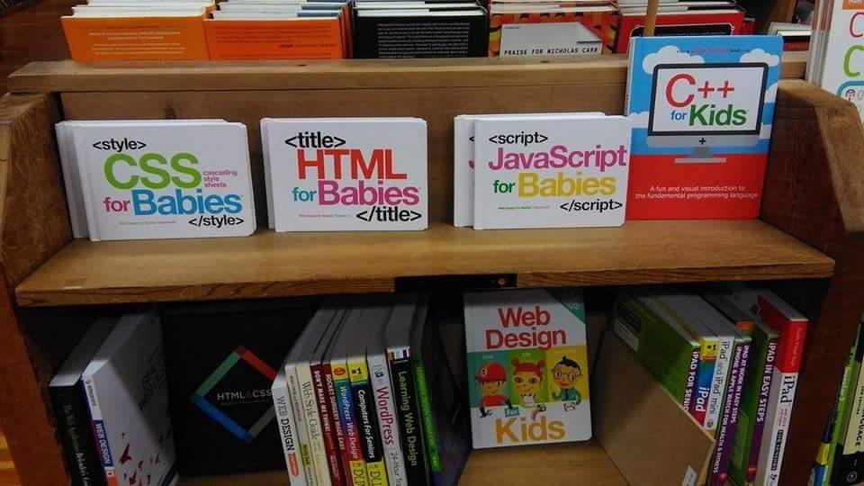
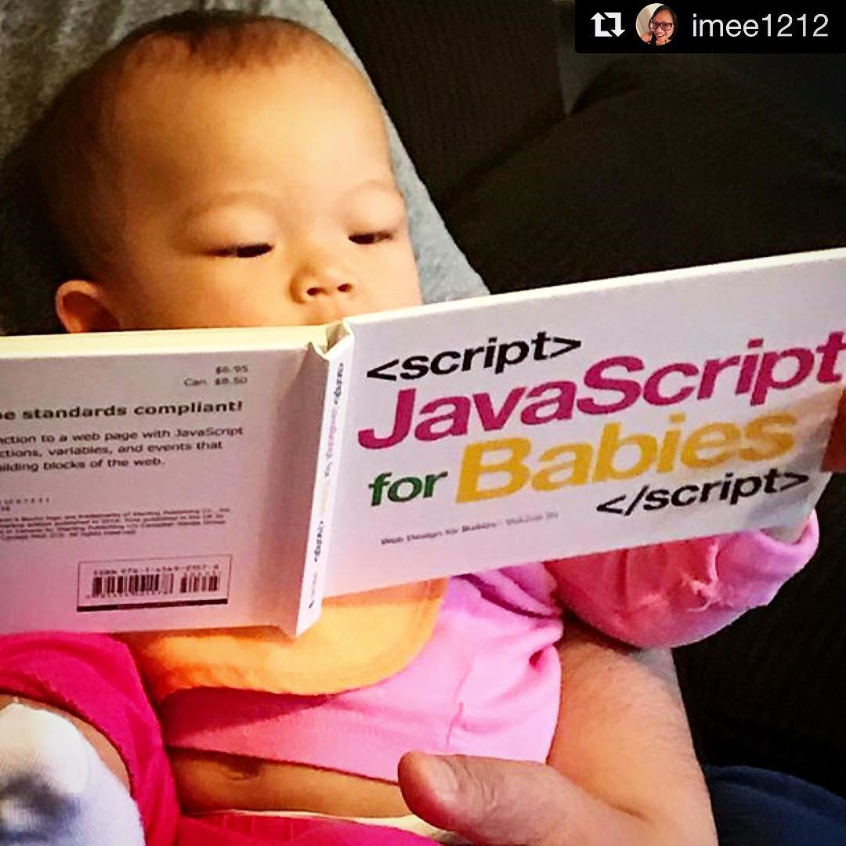
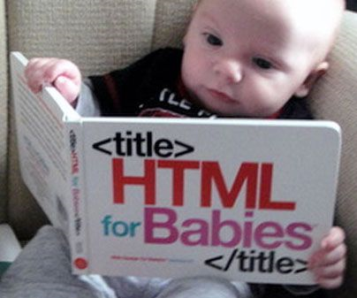
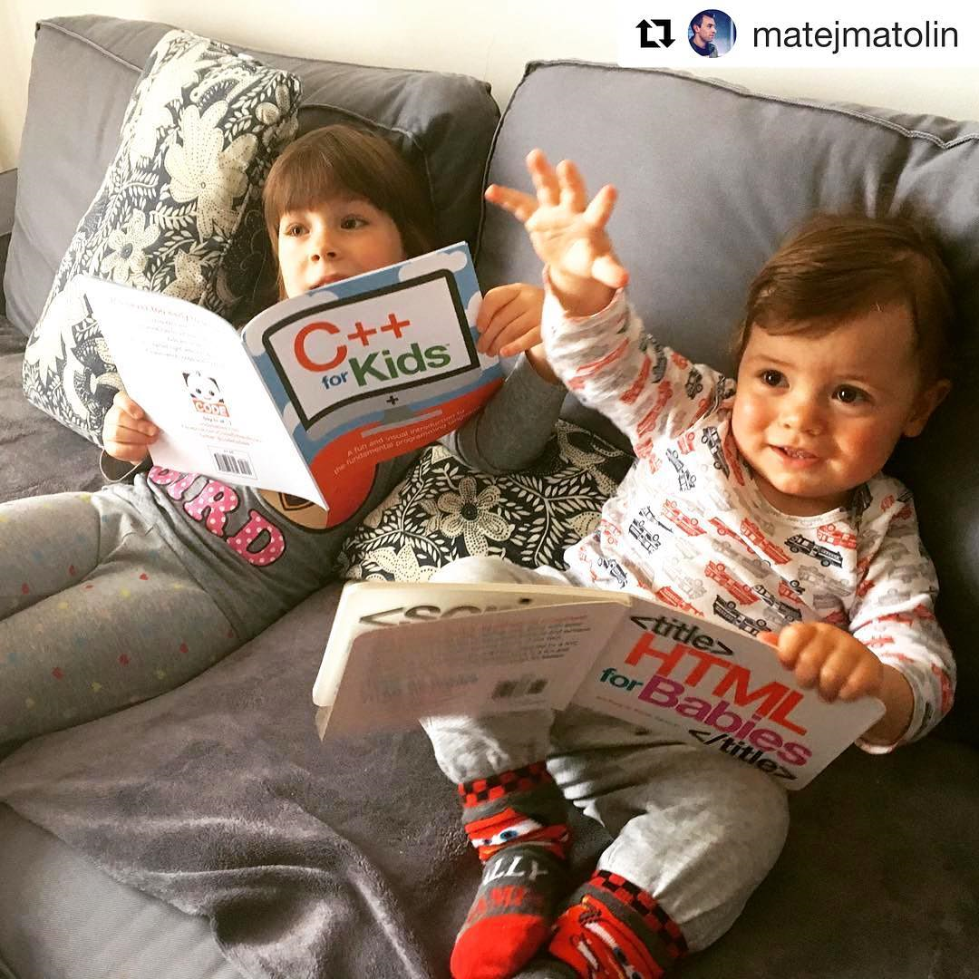
Why? … do we learn programming

Slide 24
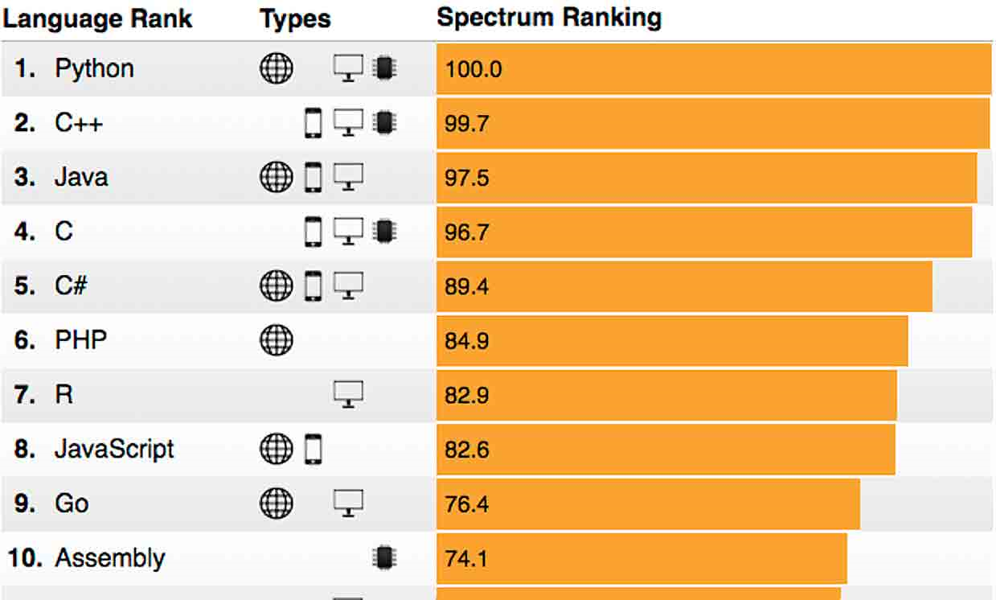
Why? … do we learn C++

Slide 25
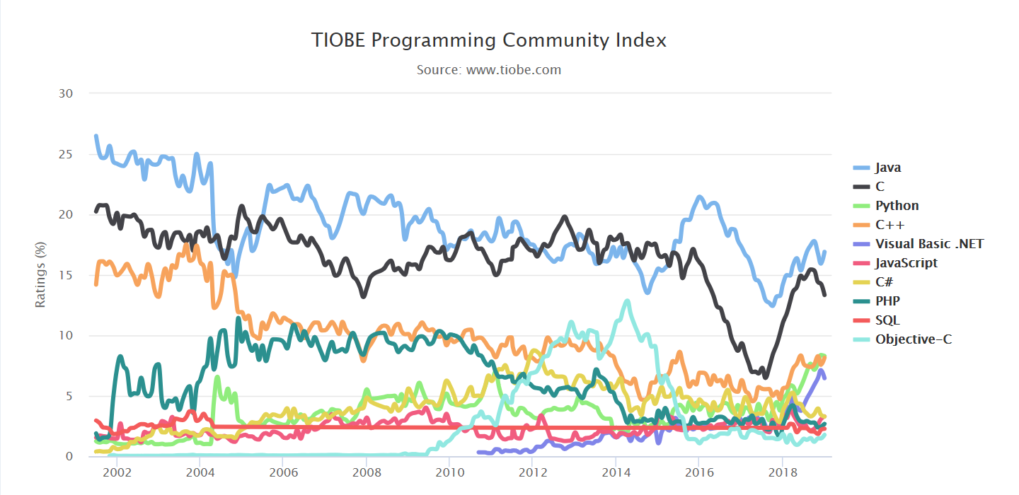
The TIOBE Programming Community index is an indicator of the popularity of programming languages. The ratings are based on the number of skilled engineers world-wide, courses and third party vendors.

Slide 26
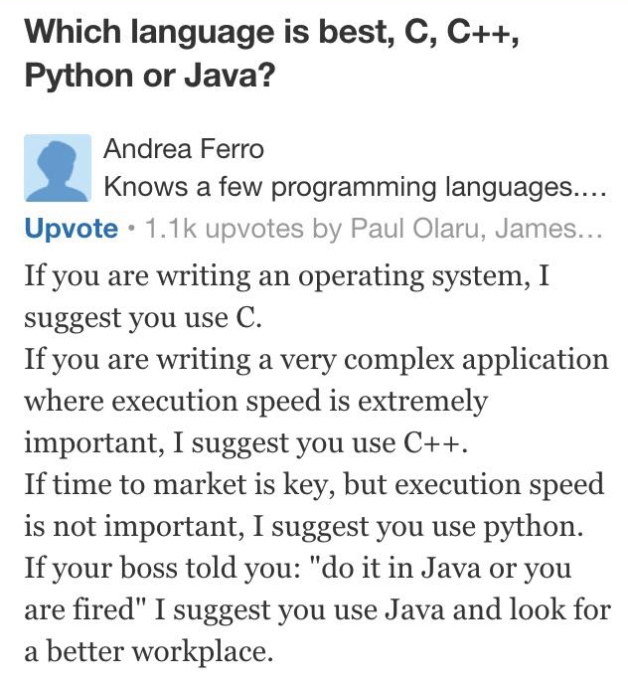

Slide 27
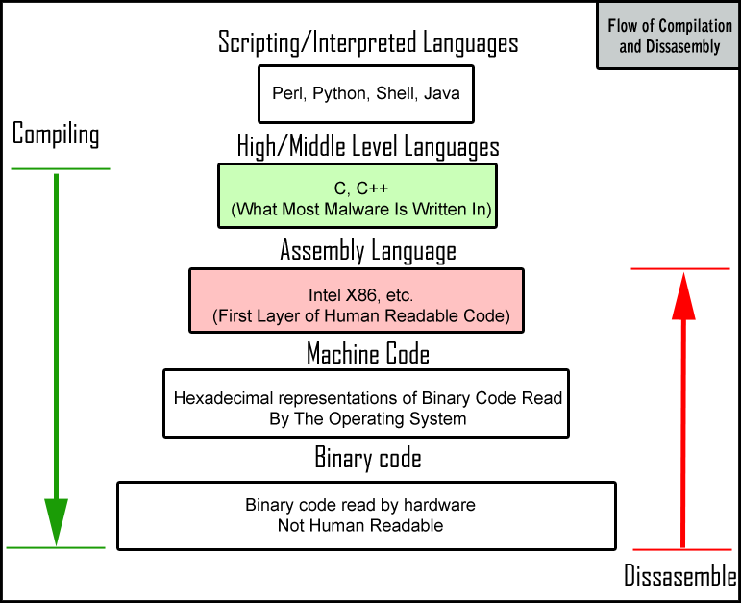
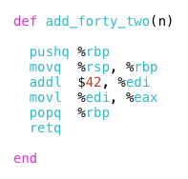
Systems are

Slide 28
C++ vs. Python
 | C++ | Python
Execution | Compiled and linked into an executable. | Interpreted and executed by an engine.
Memory Management | Requires much more attention to bookkeeping and storage details | Nearly no attention to be paid to memory management.
Types | Explicitly declared, bound to names, checked at compile time, and strict until they're not | Bound to values, checked at run time, and are not so easily subverted, an order of magnitude simpler.
Language Complexity | Complex and full-featured. C++ tries to give you every language feature under the sun while at the same time never (forcibly) abstracting anything away that could potentially affect performance. | Simple. Python tries to give you only one or a few ways to do things, and those ways are designed to be simple, even at the cost of some language power or running efficiency.

Slide 29
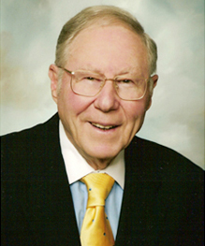
How?
“We Learn . . . 10% of what we read 20% of what we hear 30% of what we see 50% of what we both hear and see 70% of what we discuss 80% of what we experience 95% of what we teach others.”
-- William Glasser
(May 11, 1925 – August 23, 2013)
American psychiatrist

Slide 30
How?
How much time you need (at least)?
In the classroom, try not to read every word on the slides and get distracted, listen to what I’m saying carefully.
Activity | Hours/week
Lecture | 3
Tutorial | 1
Readings & Assignments | 6 (minimal)

Slide 31
How? Tentative Assessment Scheme
Component/method | % weight | Learning strategy
Programming Assignments | 30% | This is the basis of how you can pass this course.
Midterm Exam | 10% | This is really a free bonus if you stick to your plan.
Project | 30% | This is how you secure a “B”.
Final Exam | 30% | This is where you rise and shine (“A-/A”). Read the text.
Bonus | Up to 5% | attendance, classroom interaction, catching bugs, etc.

Slide 32
How? Lessons from the previous runs
The biggest complain was about the heavy workload. Unfortunately, C++ is an extremely complex language. Even with the heavy workload I put on you, it’s still not enough. You’ll have to spend a lot of time to learn a lot of things outside the classroom.
You WILL encounter a lot of problems in the beginning, with compilers, IDEs, libraries, etc., but don’t give up because of the frustration. We are here to help, especially the USTFs, who understand your pain.
Form your project team as early as possible! It can also function as a study group. It is always very helpful to study together.

Slide 33
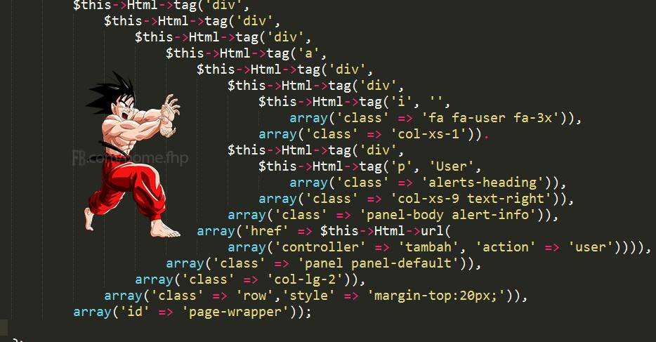
How? Lessons from the previous runs
Late policy
Hofstadter’s Law: it always takes longer than you think, even when you take Hofstadter’s Law into account.
If something unexpected (better be extraordinary) happened, get an extension approved by the TAs and CCed to the instructor before the deadline.
Correctness: test your program as thoroughly as possible
Style matters!

Slide 34
How? Lessons from the previous runs
There seems to be no objective grading criterion on the projects. The bad news is, well, programming is an art!
Do your best, show your effort, and try to learn more than everyone else in the same semester, instead of less just for a passing score.

Slide 35
How? Lessons from the previous runs
If you wait until the last minute to work on your project, you won’t be able to finish it, and you will probably even lose the 10% proposal score.
Even worse, you will be tempted to do something bad, and really regretful (e.g., plagiarism, etc.), and you will most probably be caught!
My suggestion: get it to work first, then refine.

Slide 36
Academic Honesty
Declaration of originality
VeriGuide: plagiarism detection
Everyone will be asked to explain to the TA or the instructor, a randomly chosen block of code from his/her own assignments or project, at least once, sometime during the semester.

Slide 37
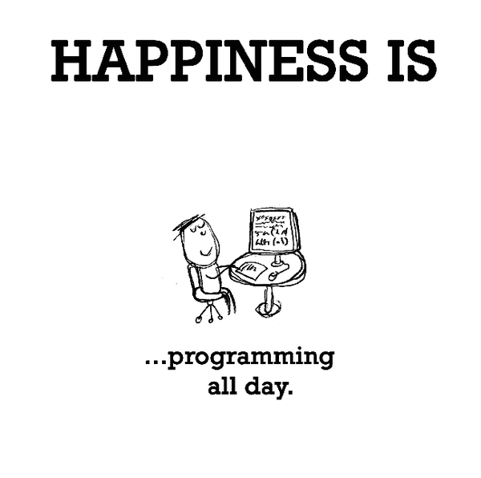
Questions?

